Slide 1
The selection and operation of flow cells as a partner for conventional batteries for electrical grid support. Confirmation review 20th November 2018
Researcher: Diarmid Roberts
Supervisors: Dr. Solomon Brown, Prof. Andy Cruden, Dr. Rachael Rothman
Sponsor: Drax Power Ltd.

Slide 2

Redox Flow Batteries: What?
Energy stored as solution in tanks
Pumped through electrochemical cell “stack” to generate power
Analogous to fuel cell
DC-DC efficiency ~75%
Catholyte
Anolyte
e⁻
e⁻
Discharge

Slide 3
Redox Flow Batteries: why?
Key properties:
Energy and power rating are decoupled
Low incremental cost of energy capacity ($/kWh)
Possibility of long cycle life
Applications:
Suitable properties for energy management (multi-hour)
Can also capture fast-response services
Interesting from system optimisation perspective!

Slide 4
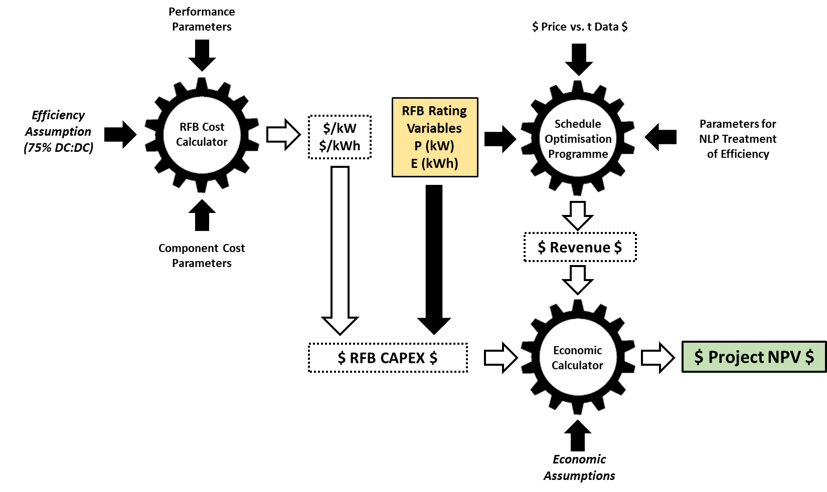
Redox Flow Batteries: TEA framework
A higher resolution TEA than previous works.

Slide 5
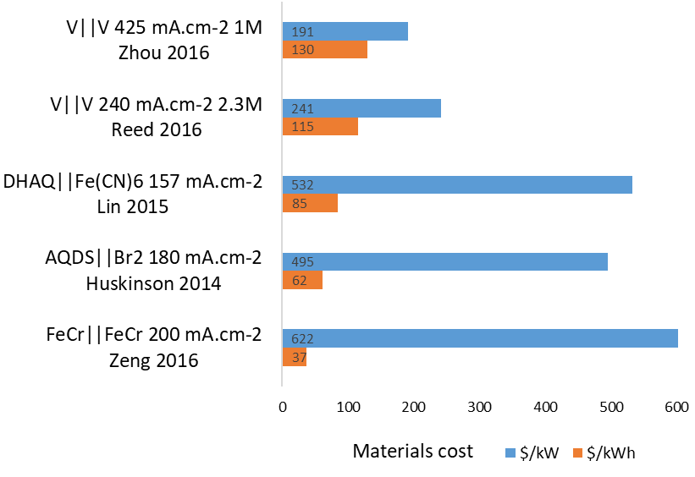
Work so far: RFB cost model
A bottom up cost model has been developed
$/kW materials cost for vanadium systems:
Cost breakdown varies depending on system design.
Wide variety within RFB stable.

Slide 6
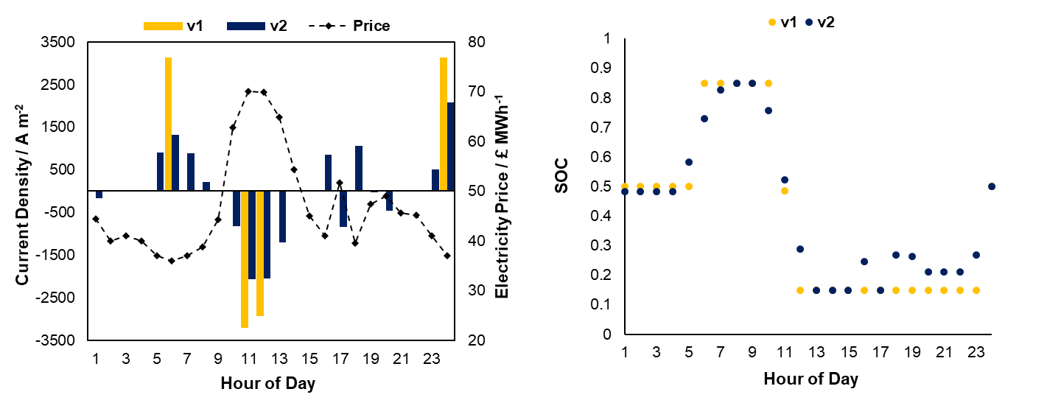
Work so far: revenue under optimal operation
Improved optimisation method for RFB schedule has been developed.
More accurate TEA. Looking to submit article this month.

Slide 7
Next steps
Extend RFB cost model to include manufacture, installation etc.
Pose revenue optimisation for more lucrative application
Going to look at behind the meter for PV self-consumption and network charge avoidance
UK / Australia / California etc.
Investigate hybrid systems, e.g. RFB + Li-ion
Investigate potential of lower TRL systems

Slide 8
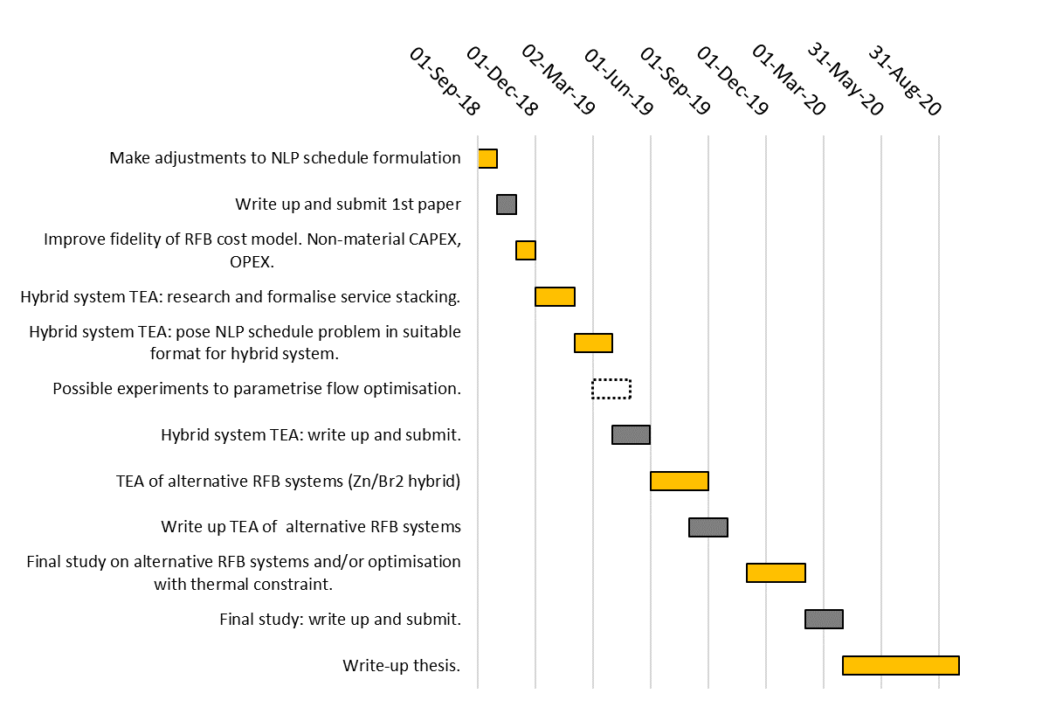
Next steps

Slide 9
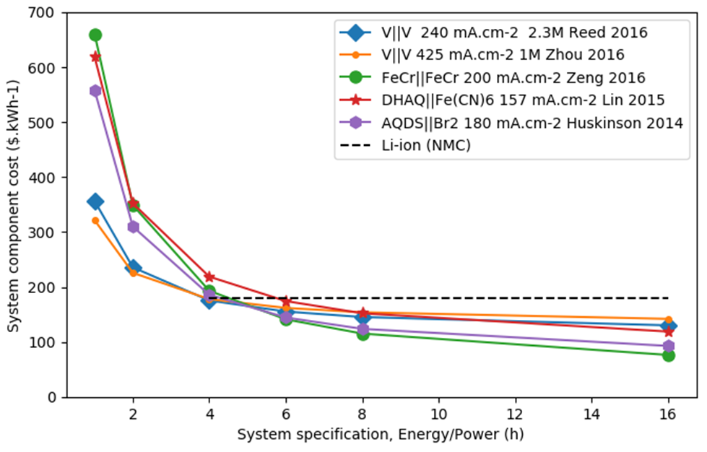
Work so far: RFB cost model
CAPEX competitive with Li-ion when required E:P ~4h and higher.

